Slide 1

Fundamentals of Automated Testing
Basics of Unit Testing and Test Driven Development
Peter Starefeldt

Slide 2
Agenda
Why Automated Tests?
Testing pyramid
Unit Tests
Integration Tests
User Interface Tests
Demo – Unit Testing (C#)
Test Driven Development (TDD)
What is TDD?
Starting with the test
Having a failing test
Refactoring
Demo – TDD (C#)

Slide 3
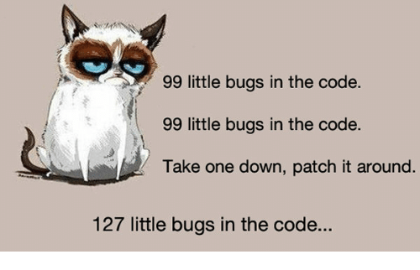
Why automated tests?
Teams can:
Hinder and find regression fast
Confidence when changing code

Slide 4
Why automated tests?
Teams can:
Hinder and find regression fast
Confidence when changing code
Get immediate feedback
Save money

Slide 5
Why automated tests?
Teams can:
Hinder and find regression fast
Confidence when changing code
Get immediate feedback
Save money
Manual testing is:
Inaccurate
Slow
Repetitive
Can become boring
Needed in most apps

Slide 6
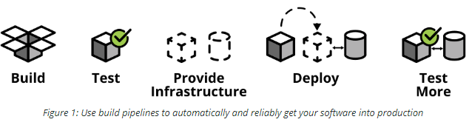
Why automated tests?
Continuous Integration/ Continuous Deployment (CI/CD)
Automated build and release
Basically a faster way to get code into production
Quality assurance -> Automated Tests!
Ham Vocke. The Practical Test Pyramid.
Hämtad 2019-06-25. https://martinfowler.com/articles/practical-test-pyramid.html

Slide 7
Testing pyramid
More
integration
Slower
UI Tests
Integration Tests
Unit Tests
More
isolation
Faster
Mike Cohn. Succeding with Agile
(New Jersey: Addison-Wesley Education Publishers Inc, 2009).

Slide 8
Unit Tests
More
integration
Slower
Developer
Small piece of code
Uses no external dependencies
Fast
Consistent
Easy to write
Unit Tests
More
isolation
Faster
Mike Cohn. Succeding with Agile
(New Jersey: Addison-Wesley Education Publishers Inc, 2009).

Slide 9
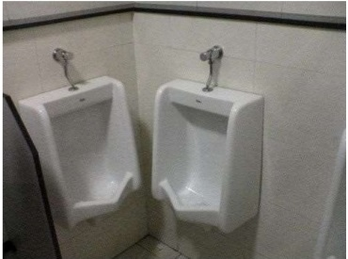
2 Unit Tests, 0 Integration Tests

Slide 10
Integration Tests
More
integration
Slower
Component tests
System Integration Tests
System Tests
Integration Tests
Unit Tests
More
isolation
Faster
Mike Cohn. Succeding with Agile
(New Jersey: Addison-Wesley Education Publishers Inc, 2009).

Slide 11
Integration Tests
More
integration
Slower
Developer
Bigger pieces of code
Uses real external dependencies
Slow
Not consistent
Harder to write
Integration Tests
Unit Tests
More
isolation
Faster
Mike Cohn. Succeding with Agile
(New Jersey: Addison-Wesley Education Publishers Inc, 2009).

Slide 12
User Interface Tests
More
integration
Slower
UI Tests
End-to-End Tests
Acceptance Tests
Functional Tests
Black-box Tests
Integration Tests
Unit Tests
More
isolation
Faster
Mike Cohn. Succeding with Agile
(New Jersey: Addison-Wesley Education Publishers Inc, 2009).

Slide 13
User Interface Tests
More
integration
Slower
UI Tests
Usually Tester
User’s perspective
Complete testing environment
Not consistent – false positives
Normal scenarios
Toughest to automate
Integration Tests
Unit Tests
More
isolation
Faster
Mike Cohn. Succeding with Agile
(New Jersey: Addison-Wesley Education Publishers Inc, 2009).

